Slide 1
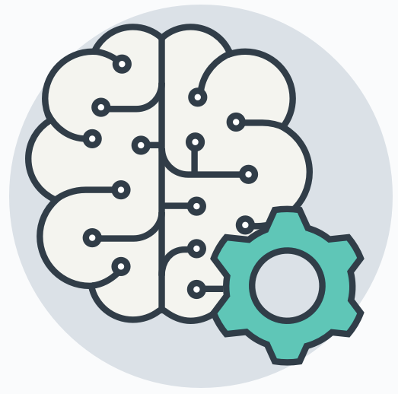
Aprendizado de Máquina Introdução
Prof. Regis Pires Magalhães
regismagalhaes@ufc.br - http://bit.ly/ufcregis

Slide 2


Slide 3


Slide 4
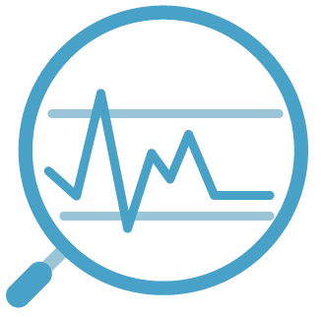
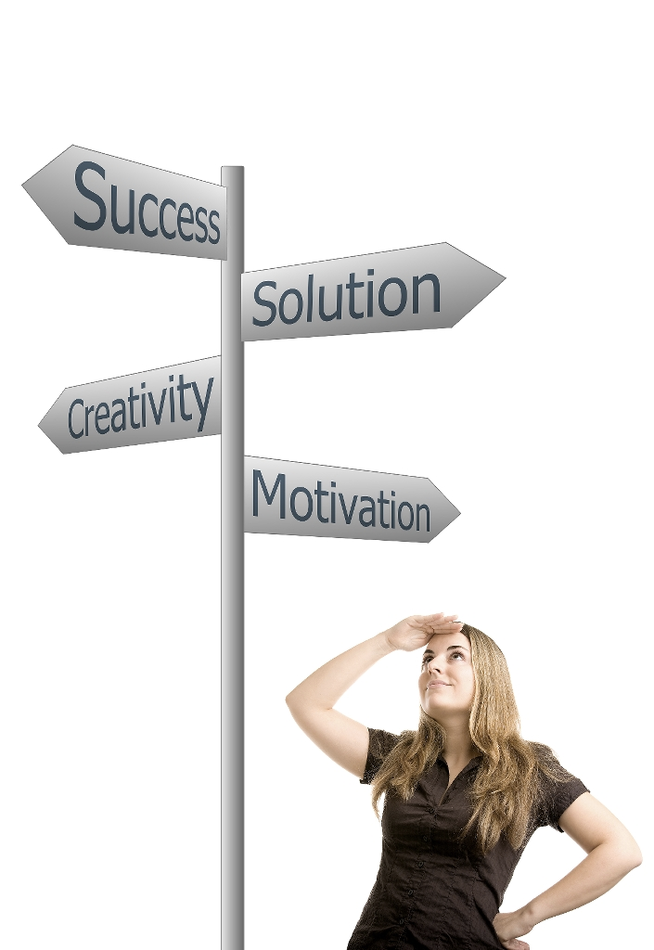
Motivações
Barateamento e popularização dos dispositivos móveis e dos mais diversos tipos de sensores para coleta de dados.
Aumento do poder de processamento e armazenamento dos computadores.
Otimização de recursos em um mercado global cada vez mais competitivo.
Amadurecimento, melhoria e disseminação de técnicas de aprendizagem de máquina.

Slide 5
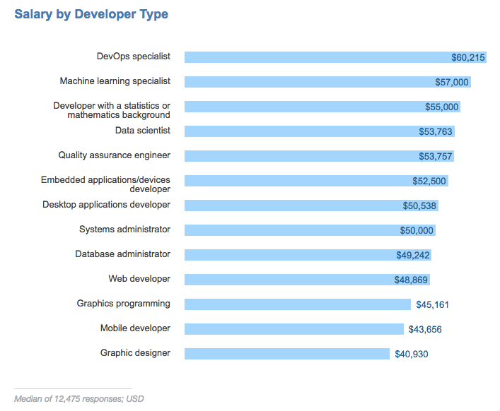
https://stackoverflow.com/insights/survey/2017/

Slide 6
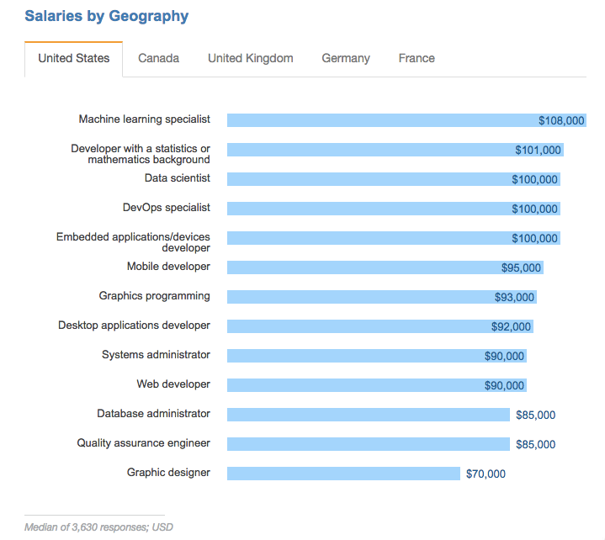
https://stackoverflow.com/insights/survey/2017/

Slide 7
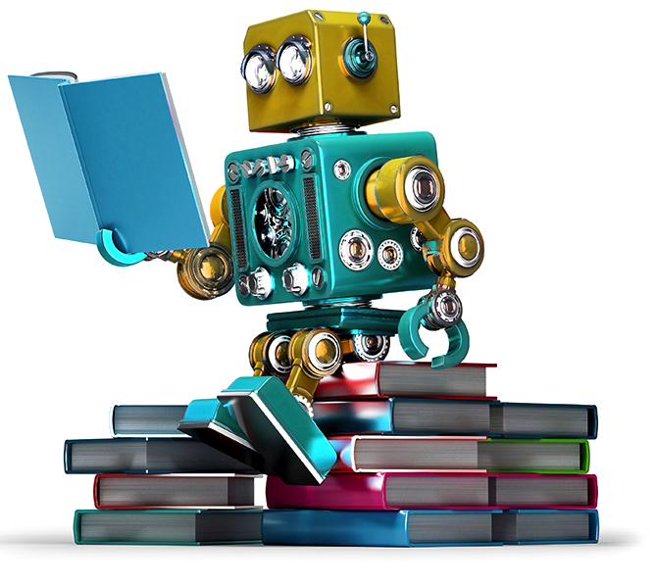
Exemplos de uso de técnicas de aprendizado de máquina
Risco de empréstimo / seguro / plano de saúde
Preços de imóveis / carros
Produtos com maior chance de venda
Sistemas de recomendação
Evasão de cursos
Probabilidade de desenvolver uma doença
Sistema de busca
Sistemas de segurança
etc.

Slide 8
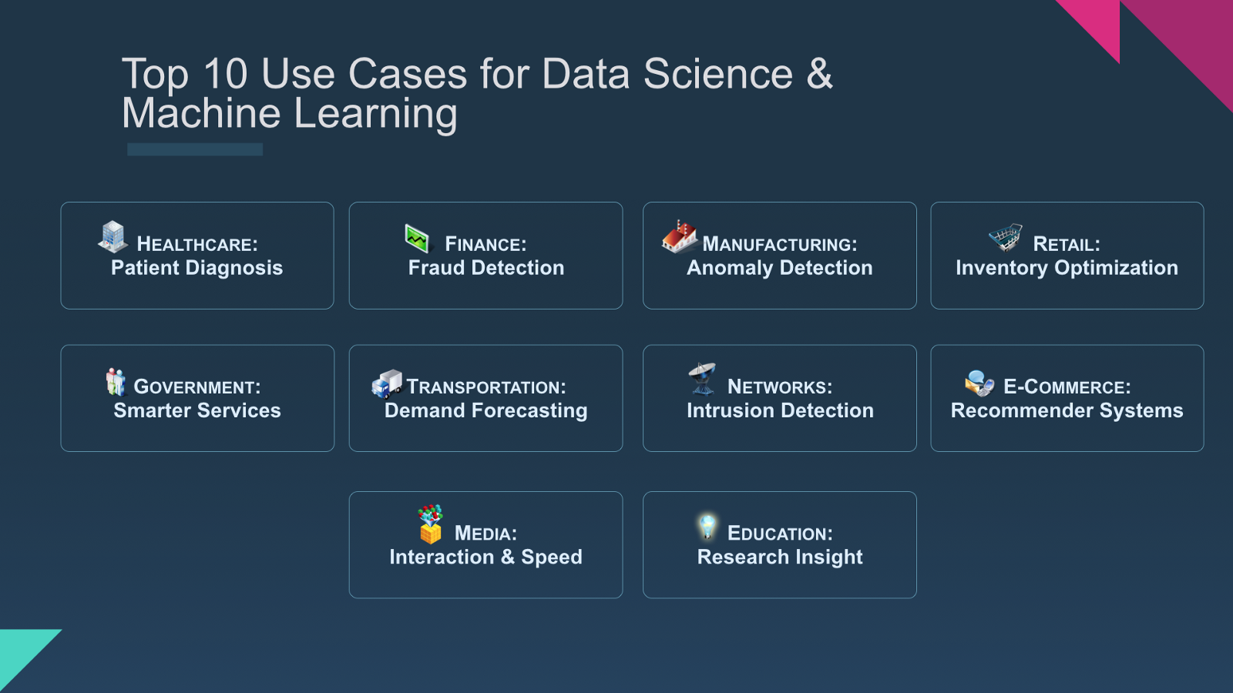

Slide 9
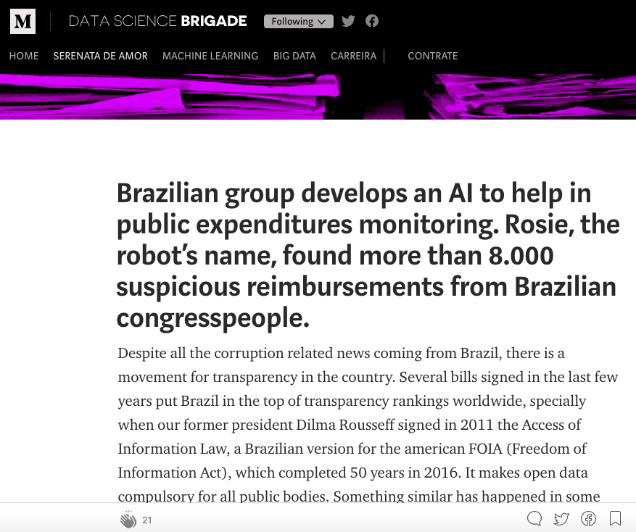

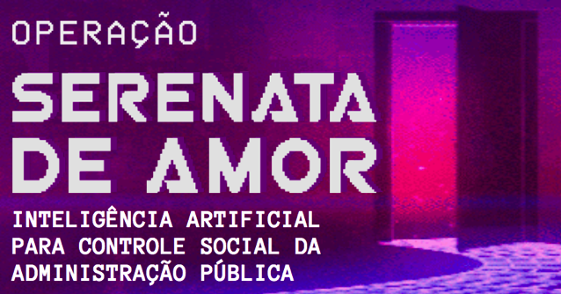
https://serenatadeamor.org/
https://medium.com/data-science-brigade

Slide 10
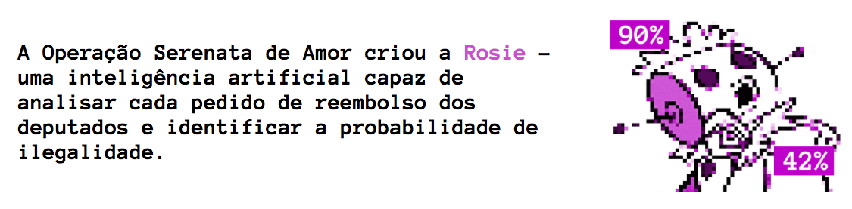
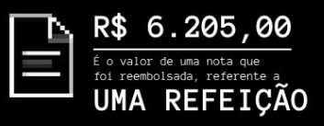
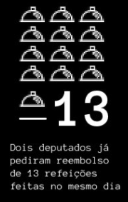
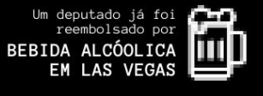
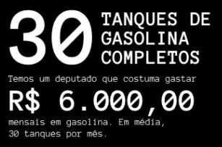
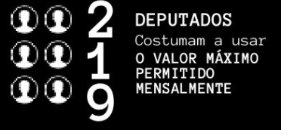

Slide 11
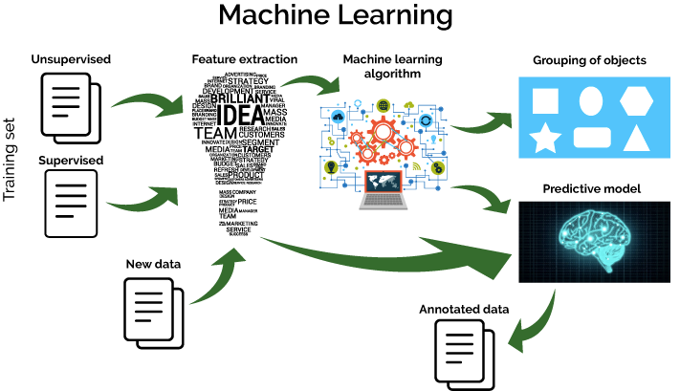

Slide 12
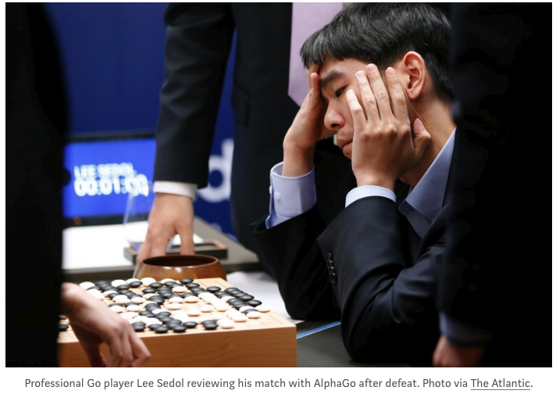

Slide 13
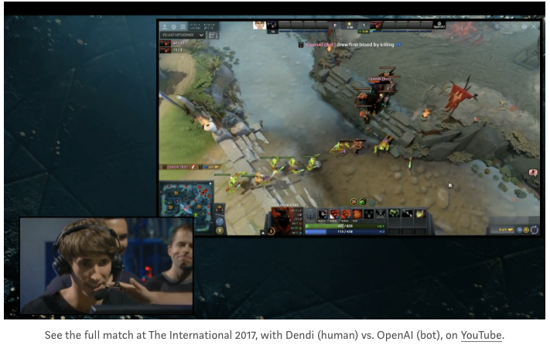
https://www.youtube.com/watch?v=wiOopO9jTZw

Slide 14
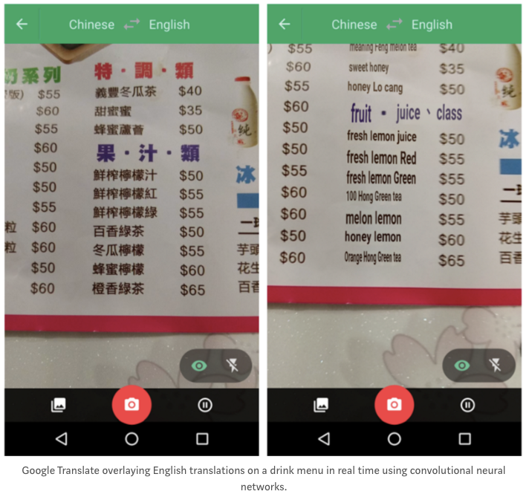

Slide 15
Usos de Machine Learning

Slide 16
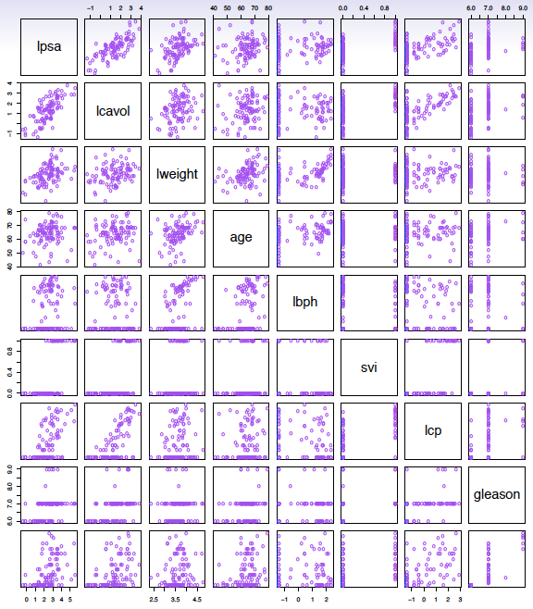
Identify the risk factors for prostate cancer
Scatter plot correlation

Slide 17
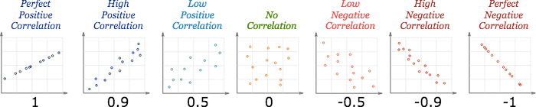
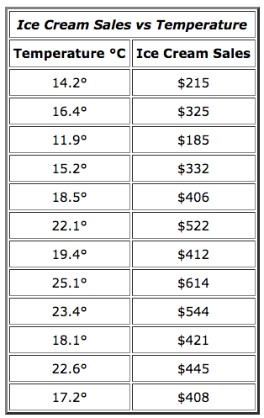
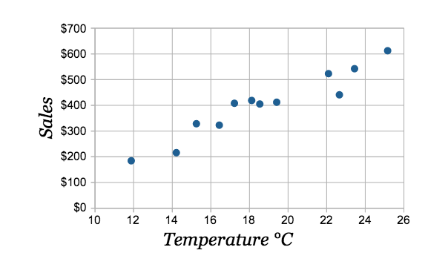
Correlação
the correlation is 0.9575

Slide 18
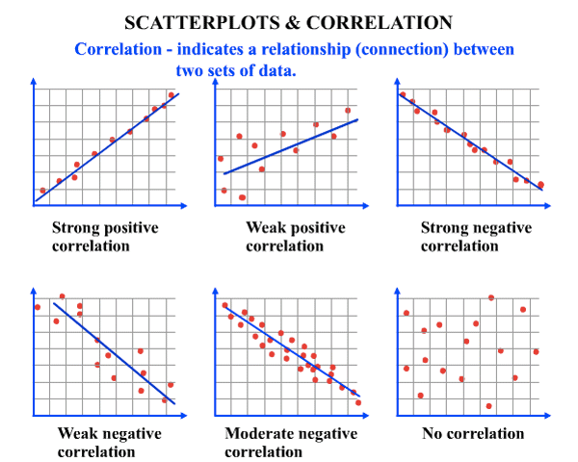

Slide 19
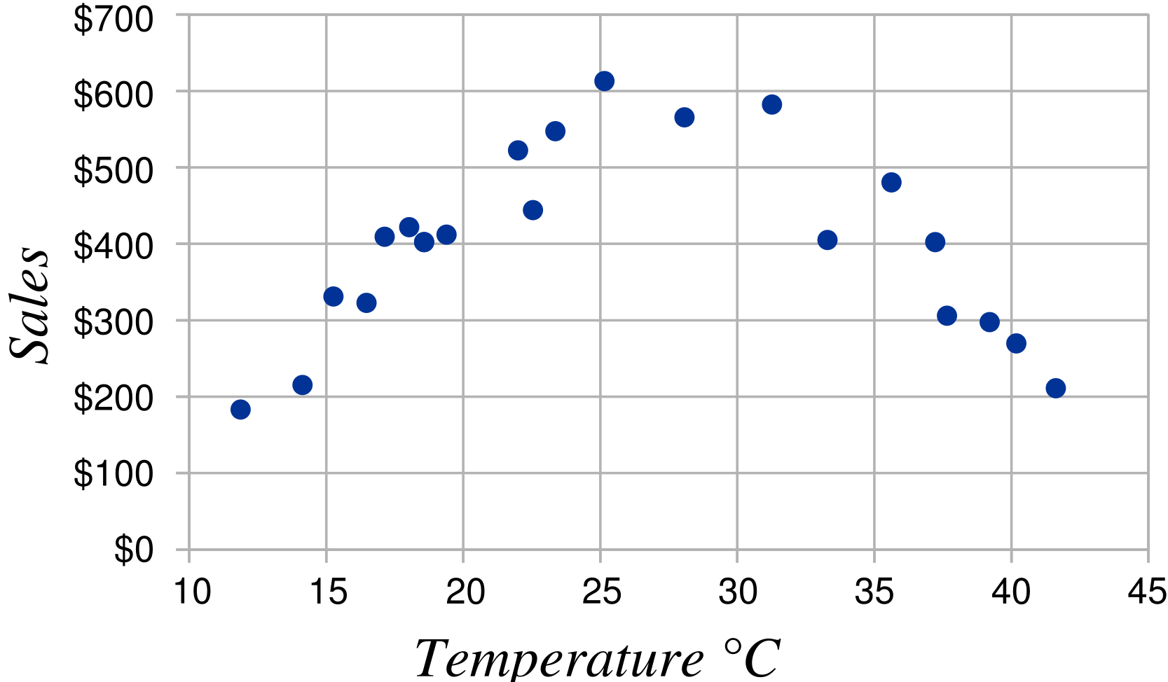
Correlação
It gets so hot that people aren't going near the shop, and sales start dropping.
The calculated correlation value is 0 (I worked it out), which means "no correlation".
But we can see the data does have a correlation: it follows a nice curve that reaches a peak around 25° C.
But the linear correlation calculation is not "smart" enough to see this.
Moral of the story: make a Scatter Plot, and look at it!
You may see a correlation that the calculation does not.

Slide 20
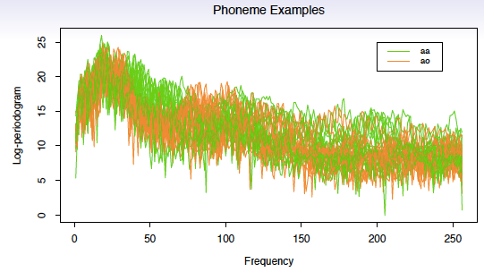
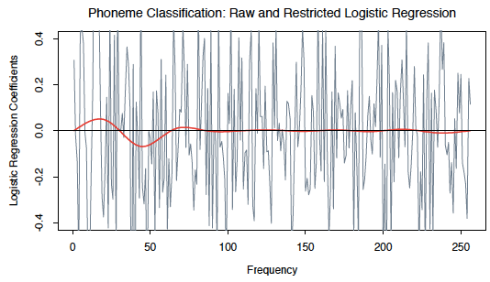
Classify a recorded phoneme based on a log-periodogram

Slide 21
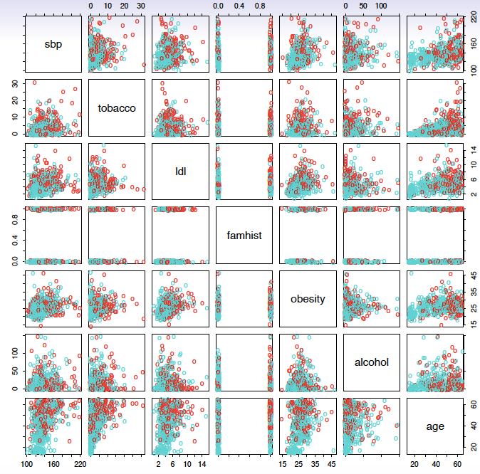
Predict whether someone will have a heart attack on the basis of demographic, diet and clinical measurements

Slide 22
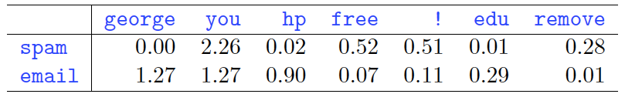
Spam Detection
data from 4601 emails sent to an individual (named George, at HP labs, before 2000). Each is labeled as spam or email.
goal: build a customized spam filter.
input features: relative frequencies of 57 of the most commonly occurring words and punctuation marks in these email messages.
Average percentage of words or characters in an email message equal to the indicated word or character. We have chosen the words and characters showing the largest difference between spam and email.

Slide 23
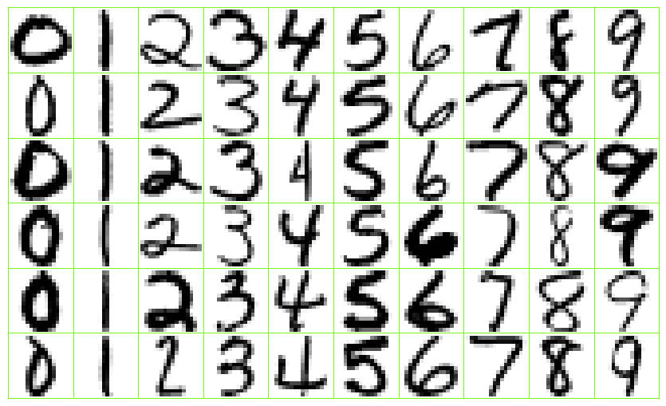
Identify the numbers in a handwritten zip code

Slide 24
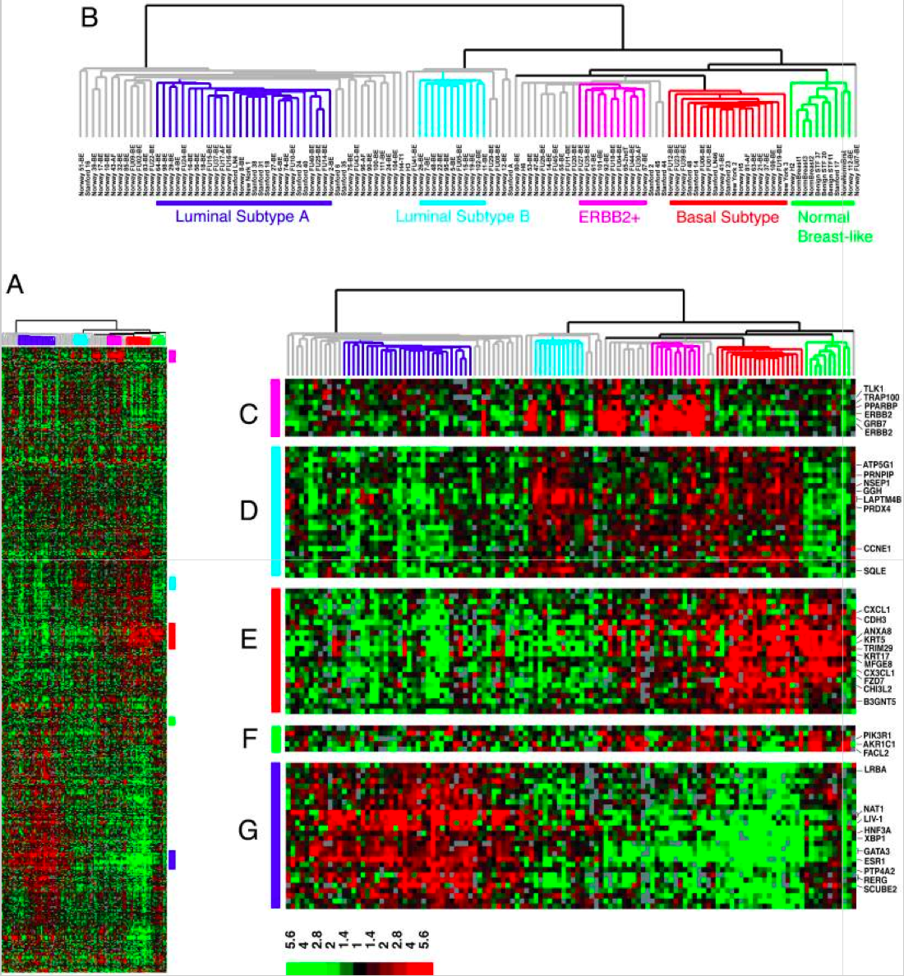
Classify a tissue sample into one of several cancer classes, based on a gene expression profile

Slide 25
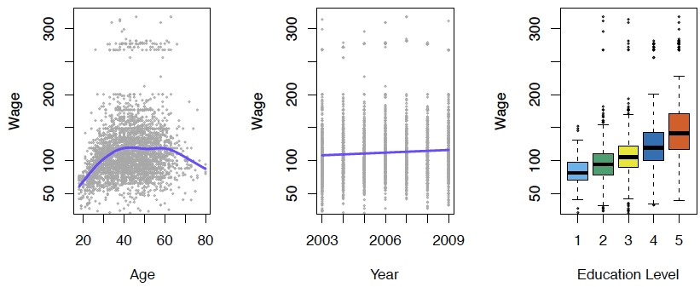
Establish the relationship between salary and demographic variables in population survey data
Income survey data for males from the central Atlantic region
of the USA in 2009.

Slide 26
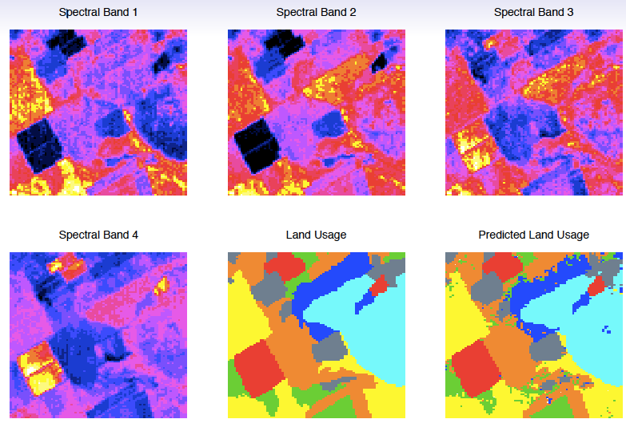
Classify the pixels in a LANDSAT image, by usage
Usage ∈{red soil, cotton, vegetation stubble, mixture, gray soil, damp gray soil}

Slide 27
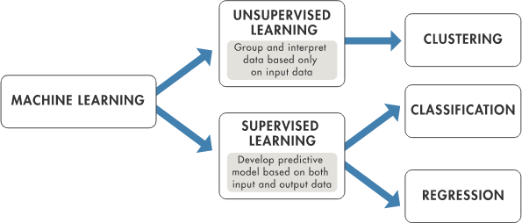

Slide 28
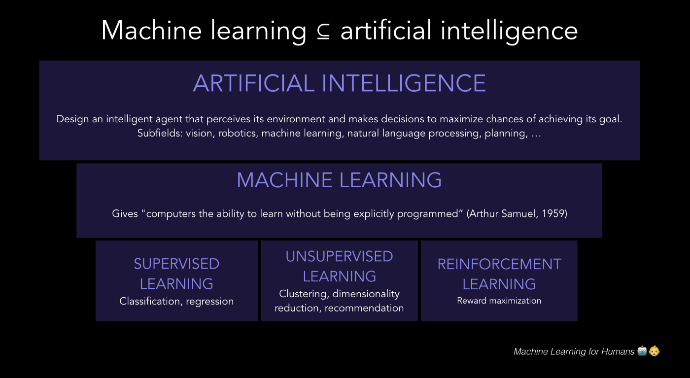

Slide 29
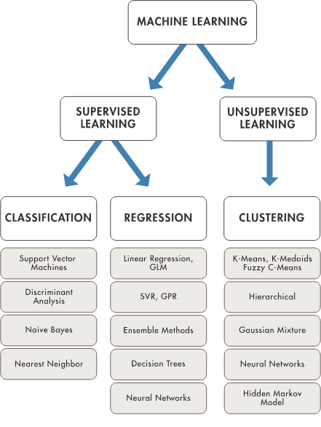

Slide 30
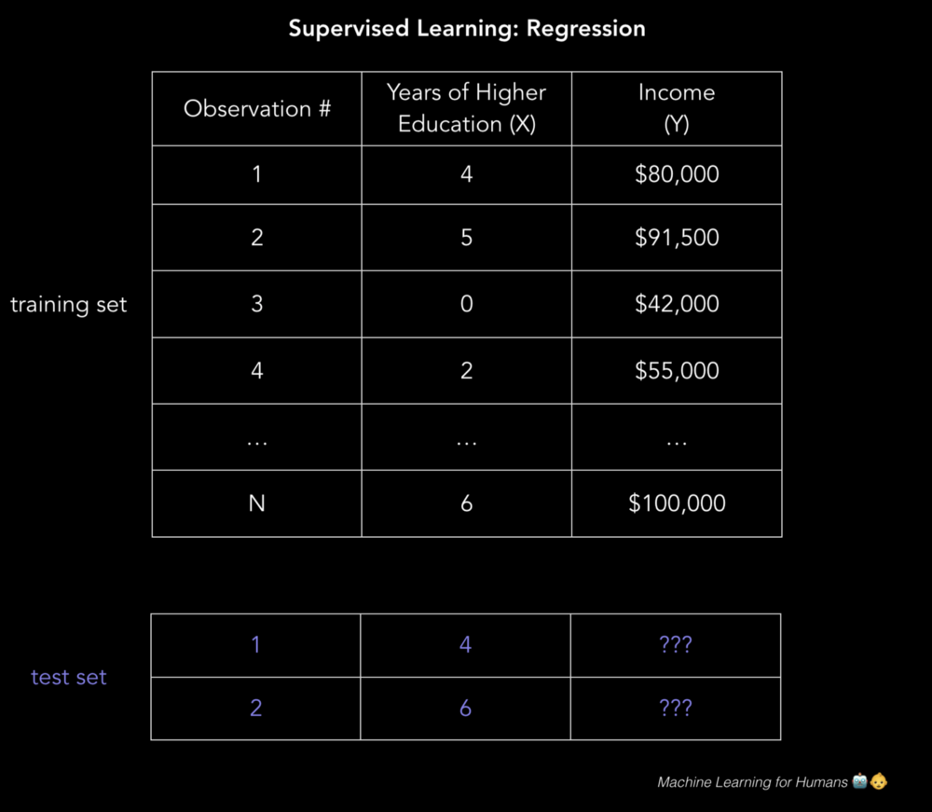

Slide 31
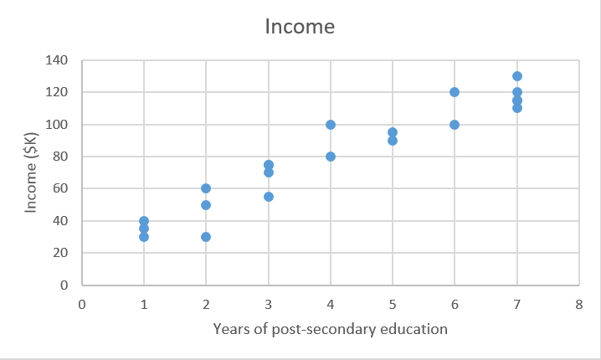

Slide 32


Slide 33
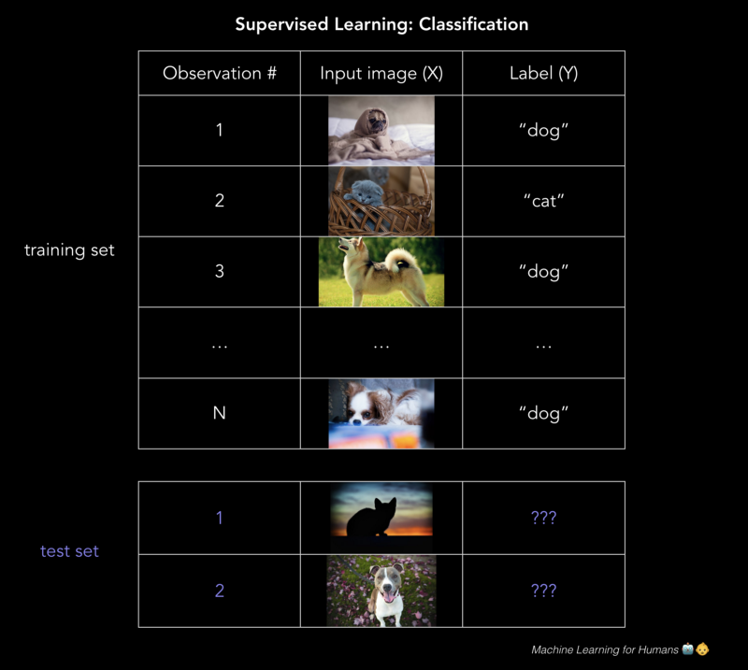

Slide 34
Aprendizagem Supervisionada
Outcome measurement Y (also called dependent variable, response, target).
Vector of p predictor measurements X (also called inputs, regressors, covariates, features, independent variables).
In the regression problem, Y is quantitative (e.g price, blood pressure).
In the classification problem, Y takes values in a finite, unordered set (survived/died, digit 0-9, cancer class of tissue sample).
^{We have training data (x}₁^{, y}₁^{),...,(x}_{N}^{, y}_{N}). These are observations (examples, instances) of these measurements.

Slide 35
Objetivos
On the basis of the training data we would like to:
Accurately predict unseen test cases.
Understand which inputs affect the outcome, and how.
Assess the quality of our predictions and inferences.

Slide 36
Filosofia
It is important to understand the ideas behind the various techniques, in order to know how and when to use them.
One has to understand the simpler methods first, in order to grasp the more sophisticated ones.
It is important to accurately assess the performance of a method, to know how well or how badly it is working [simpler methods often perform as well as fancier ones!]
This is an exciting research area, having important applications in science, industry and finance.
Statistical learning is a fundamental ingredient in the training of a modern data scientist.

Slide 37
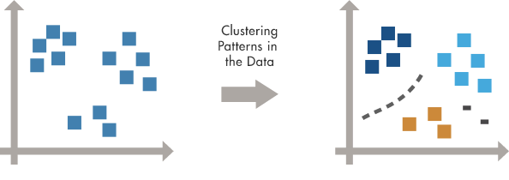
Aprendizagem não supervisionada

Slide 38
Aprendizagem não supervisionada
No outcome variable, just a set of predictors (features) measured on a set of samples.
objective is more fuzzy — find groups of samples that behave similarly, find features that behave similarly, find linear combinations of features with the most variation.
difficult to know how well your are doing.
different from supervised learning, but can be useful as a pre-processing step for supervised learning.

Slide 39
O prêmio Netflix
competition started in October 2006. Training data is ratings for 18, 000 movies by 400, 000 Netflix customers, each rating between 1 and 5.
training data is very sparse— about 98% missing.
objective is to predict the rating for a set of 1 million
customer-movie pairs that are missing in the training data.
Netflix’s original algorithm achieved a root MSE of 0.953. The first team to achieve a 10% improvement wins one million dollars.
is this a supervised or unsupervised problem?

Slide 40
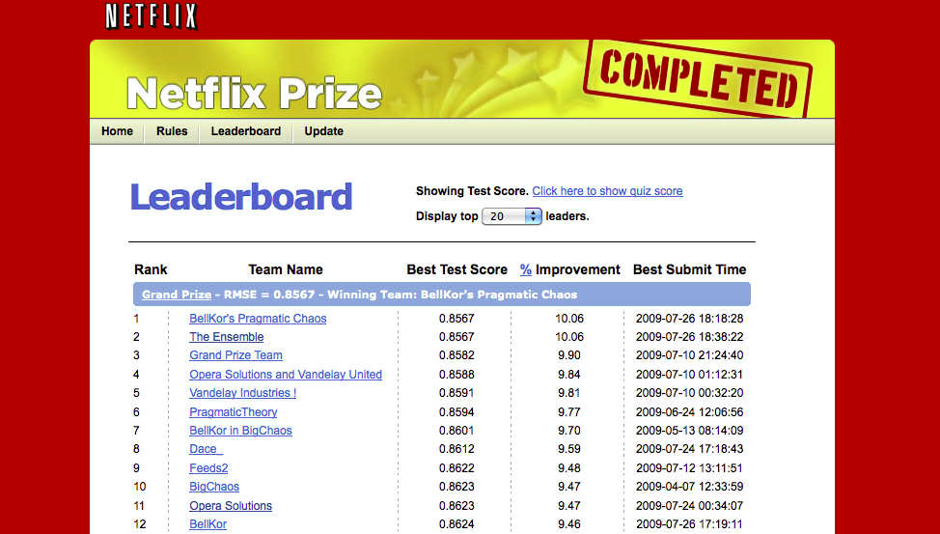
O prêmio Netflix

Slide 41
Statistical Learning versus Machine Learning
Machine learning arose as a subfield of Artificial Intelligence.
Statistical learning arose as a subfield of Statistics.
There is much overlap — both fields focus on supervised and unsupervised problems:
Machine learning has a greater emphasis on large scale applications and prediction accuracy.
Statistical learning emphasizes models and their interpretability, and precision and uncertainty.
But the distinction has become more and more blurred, and there is a great deal of “cross-fertilization”.
Machine learning has the upper hand in Marketing!

Slide 42


Slide 43
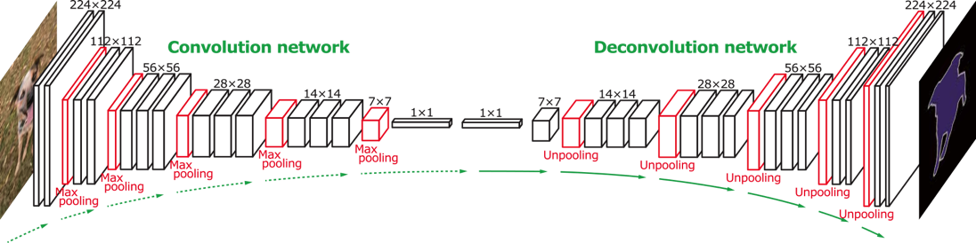
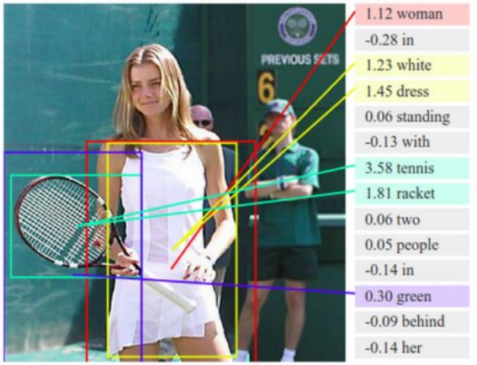
Deep Learning
Image, automatically annotated by Deep Learning.

Slide 44
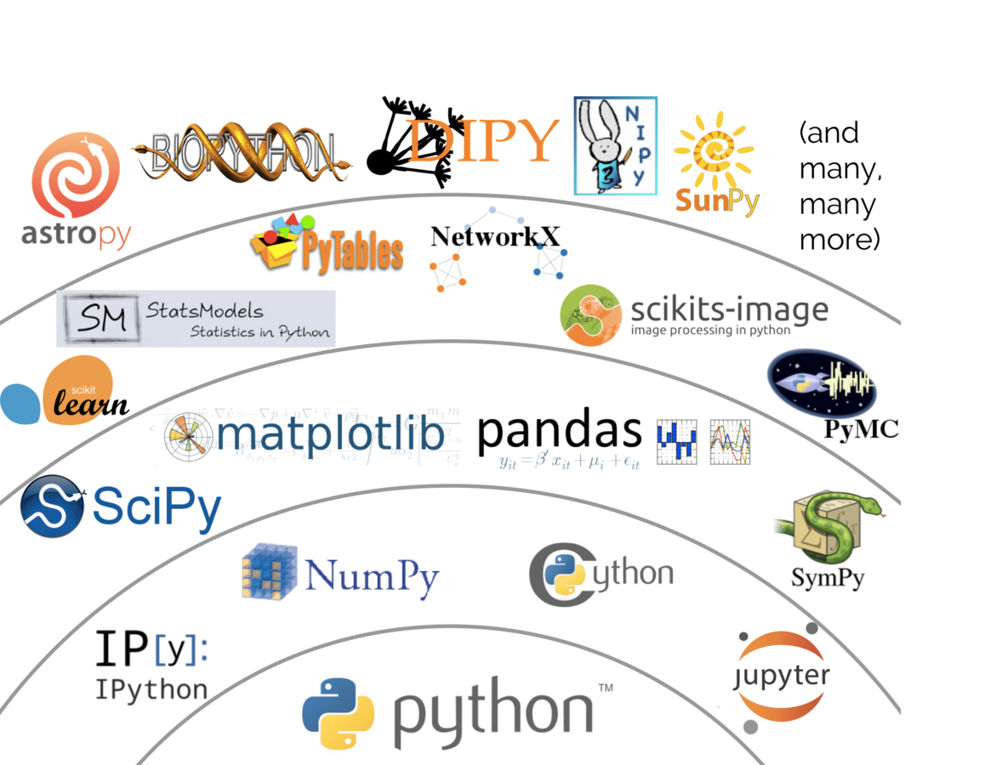
Ecossistema Python

Slide 45
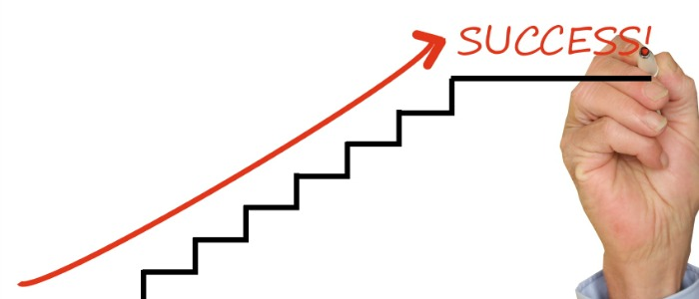
Workflow 1
Definição do problema
Análise Exploratória dos Dados
Preparar os dados
Avaliar Algoritmos
Melhorar os resultados
Apresentar os resultados

Slide 46
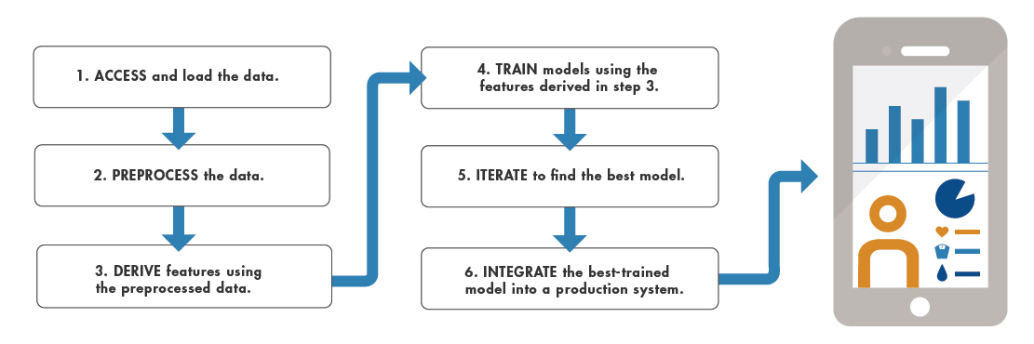
Workflow 2

Slide 47
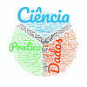
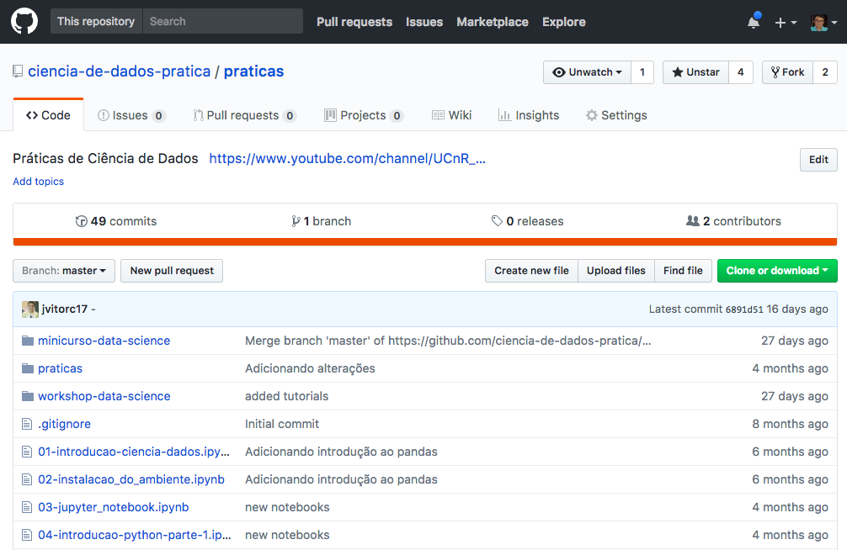
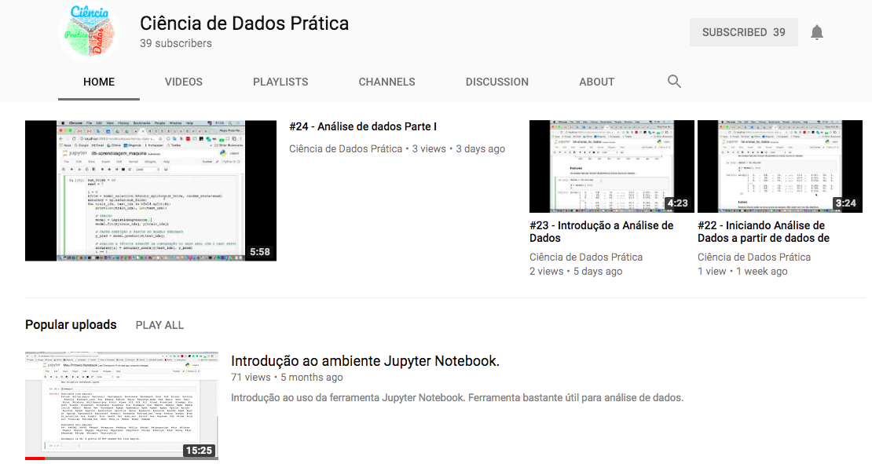
Projeto Ciência de Dados na Prática (cdp) Material didático gratuito
GitHub
http://bit.ly/cdpgithub
YouTube
http://bit.ly/cdpvideos
Facebook
http://bit.ly/cdpface

Slide 48


Obrigado!
Dúvidas, comentários, sugestões?
Regis Pires Magalhães
regismagalhaes@ufc.br

